Slide 1
The Impact of National Science Foundation (NSF) Funding on Academic Output of Scholars
Scrapers
Team Members:
Guankun Li : guankun@uchicago.edu
Jiazheng Li : jiazheng123@uchicago.edu
Tianyue Cong : tianyuec@uchicago.edu
Weiwu Yan : weiwuyan@uchicago.edu
GitHub: https://github.com/macs30122-winter24/final-project-scrapers.git
MACS 30122

Slide 2
Does funding or higher amount of funding increase the quantity or quality of academic output of scholars?
Research Questions
Which academic disciplines are more likely to be awarded funding?
MACS 30122

Slide 3
Both funding and higher amount of funding lead to higher quantity and quality of academic output.
Hypotheses
Biological Sciences are more likely to be awarded funding than Social Sciences.
MACS 30122

Slide 4
National Science Foundation: downloaded award records from 2011 to 2020 from the official website
Data Collection
Google Scholar: scraped academic backgrounds and achievements based on names and emails of award receivers
Academic Journal Sites: dynamically scraped abstracts of papers published within a three-year period both before and after the funding based on Google Scholar pages
MACS 30122

Slide 5
Descriptive Statistics
Descriptive Statistics
Variable | Obs | Mean | SD | Min | Median | Max
year | 20640 | 2015.5 | 2.872 | 2011 | 2015 | 2020
award amount | 20640 | 1.30e+05 | 2.70e+05 | 0 | 0 | 3.24e+06
ln(award amount) | 20640 | 5.280 | 5.974 | 0 | 0 | 14.990
award(binary) | 20640 | 0.444 | 0.497 | 0 | 0 | 1
total citations | 20640 | 8797.634 | 17447.221 | 1 | 3902.5 | 3.62e+05
h-index | 20640 | 33.613 | 22.731 | 1 | 29 | 192
citations | 20113 | 476.106 | 965.345 | 1 | 210 | 24631
publications | 20640 | 5.472 | 10.209 | 0 | 4 | 1129
citations of top 3 cited papers | 20004 | 84.654 | 305.650 | 0 | 33 | 22244
MACS 30122

Slide 6
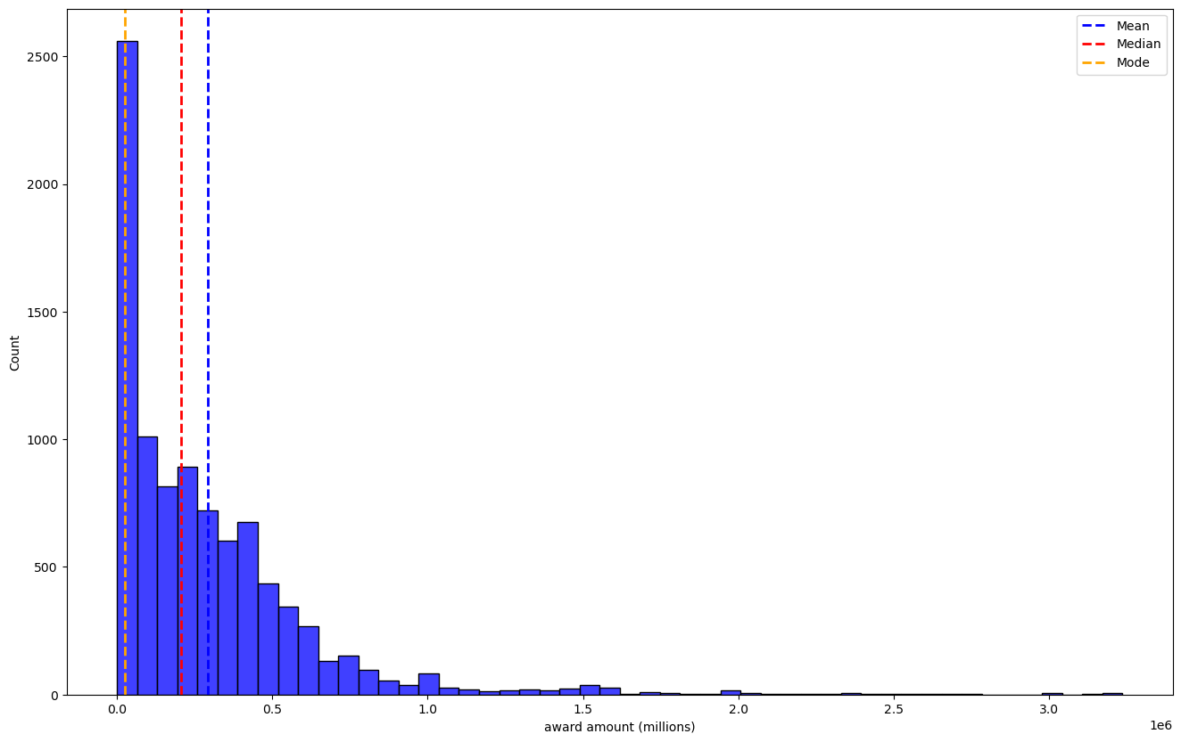
Award Distribution by Amount
MACS 30122

Slide 7
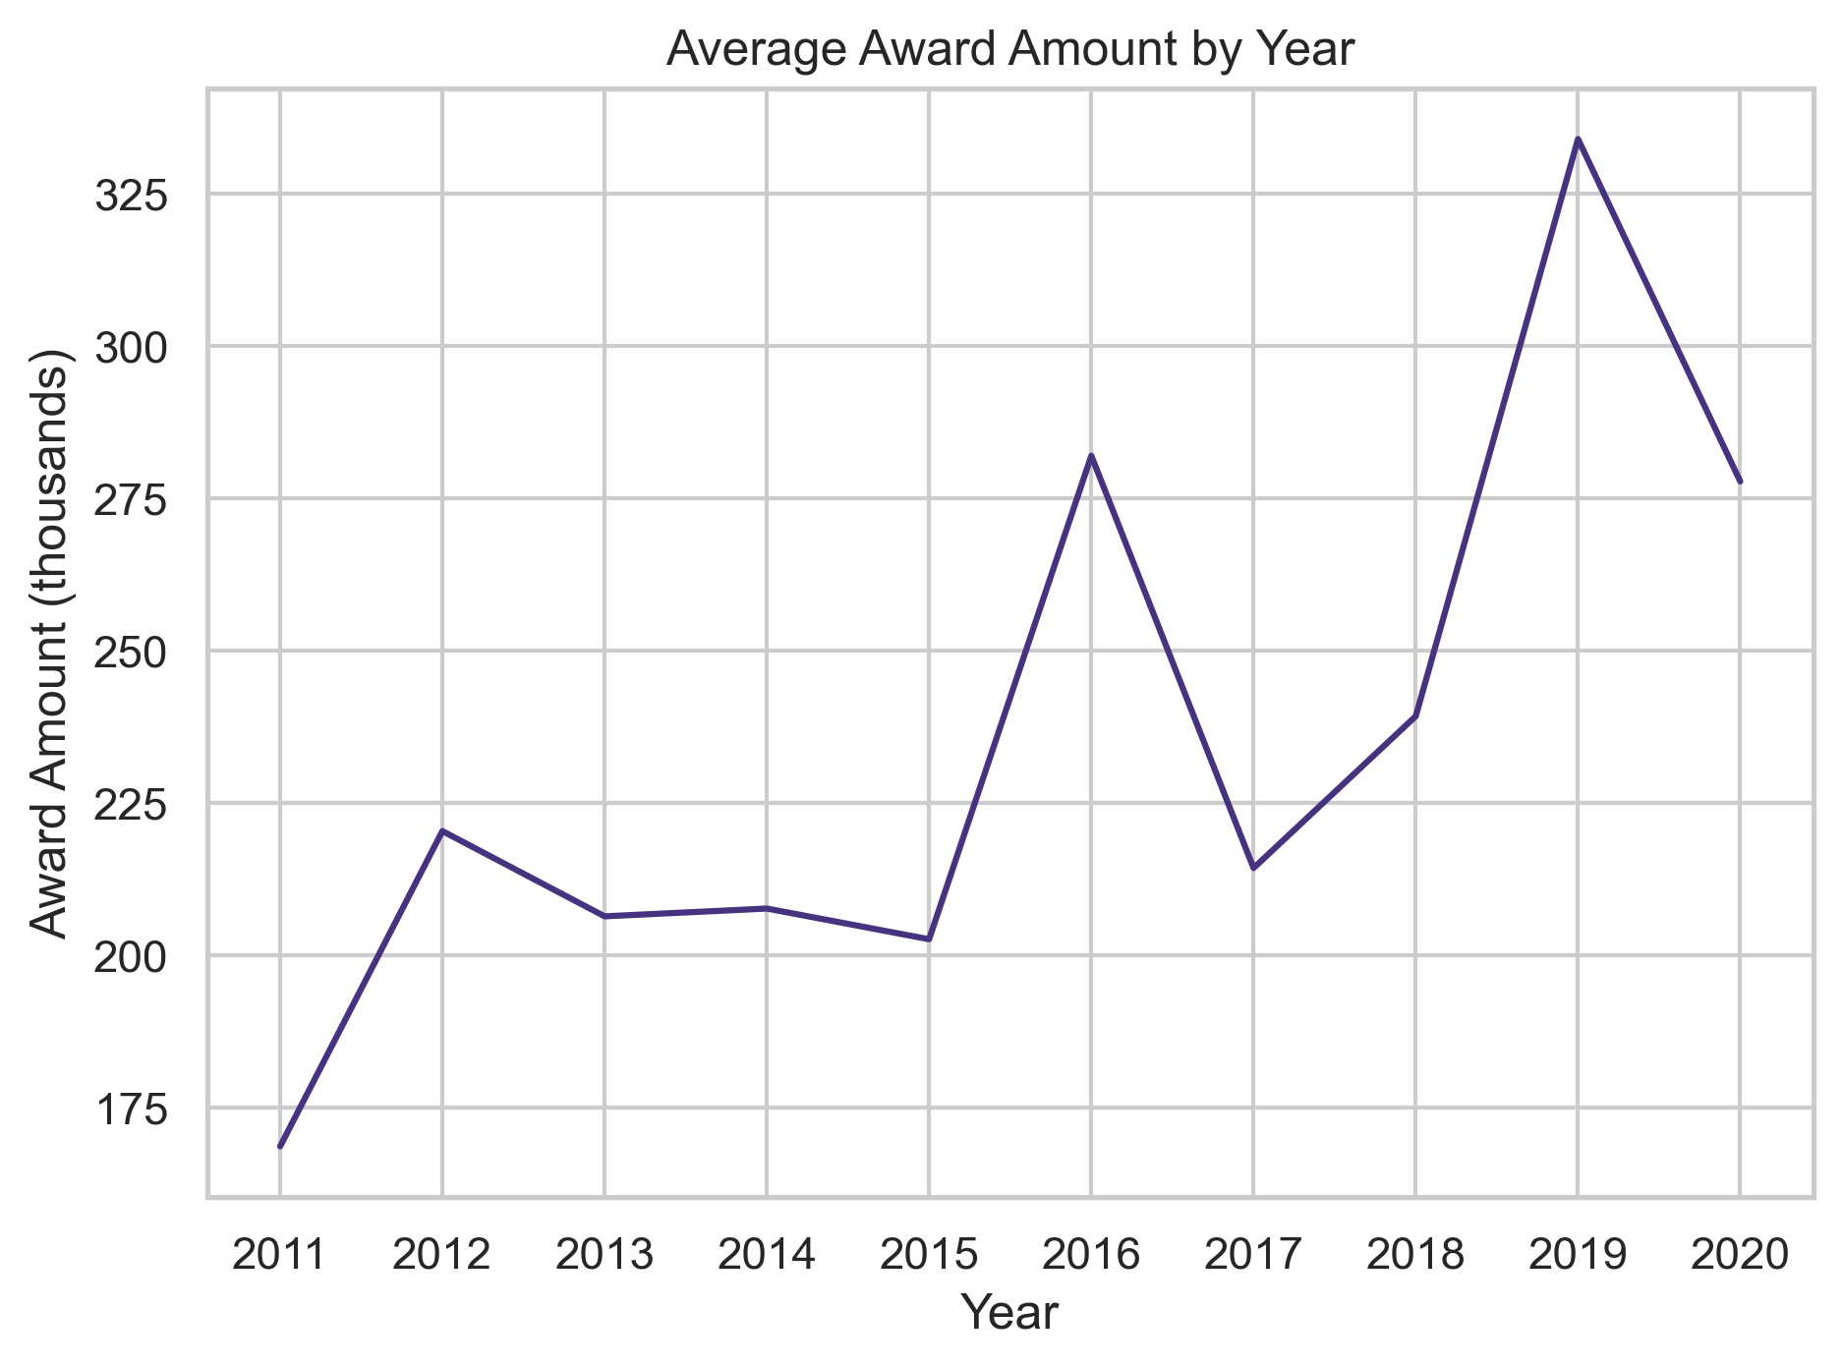
Average Award Amount by Year
MACS 30122

Slide 8
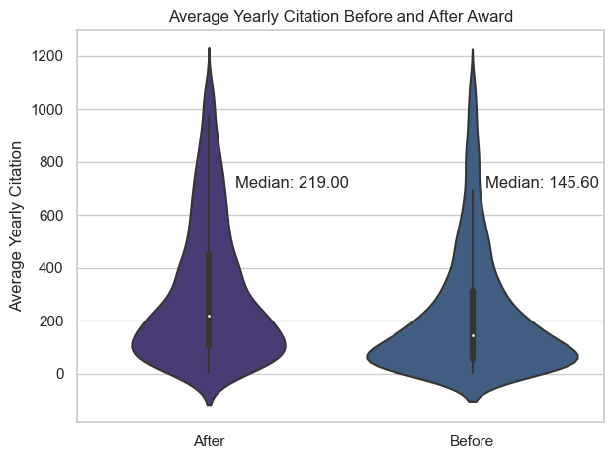
Average Yearly Citation Before and After Award
MACS 30122

Slide 9

Research Interests
MACS 30122

Slide 10
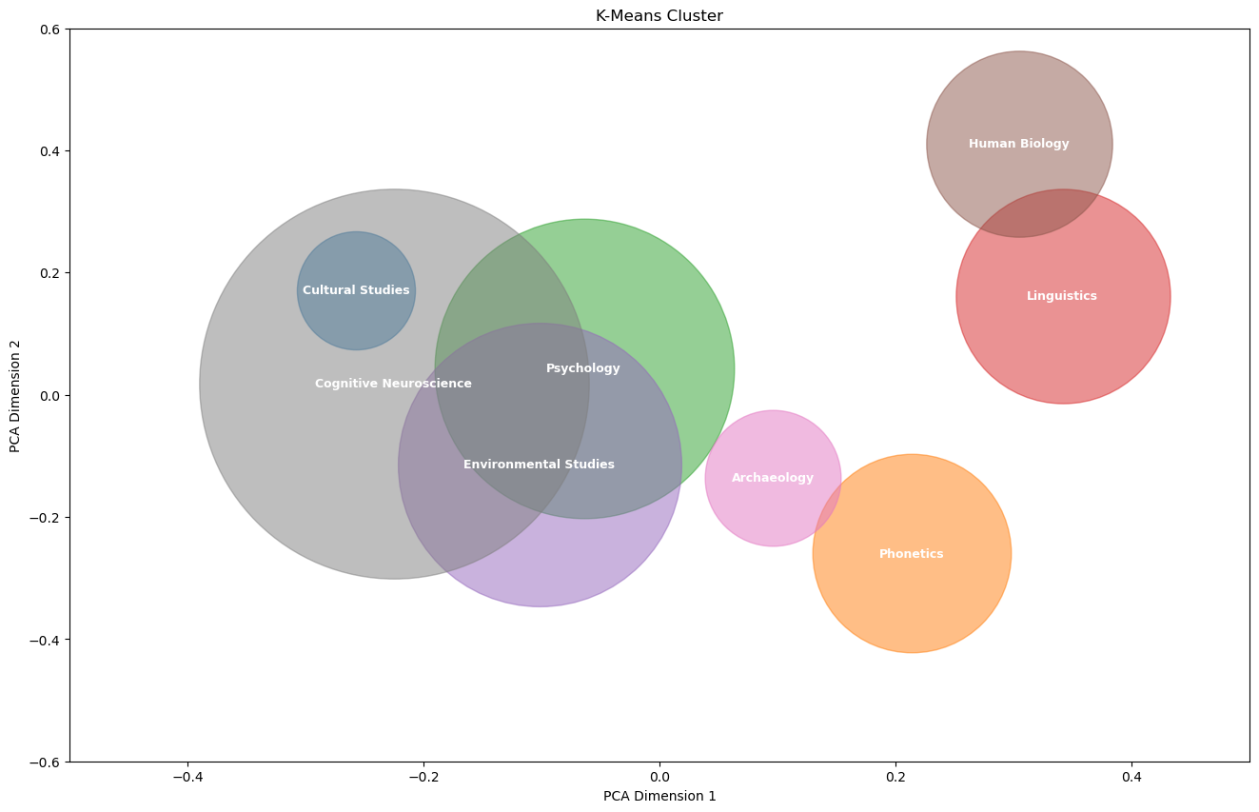
K-means Clustering with TF-IDF
MACS 30122

Slide 11
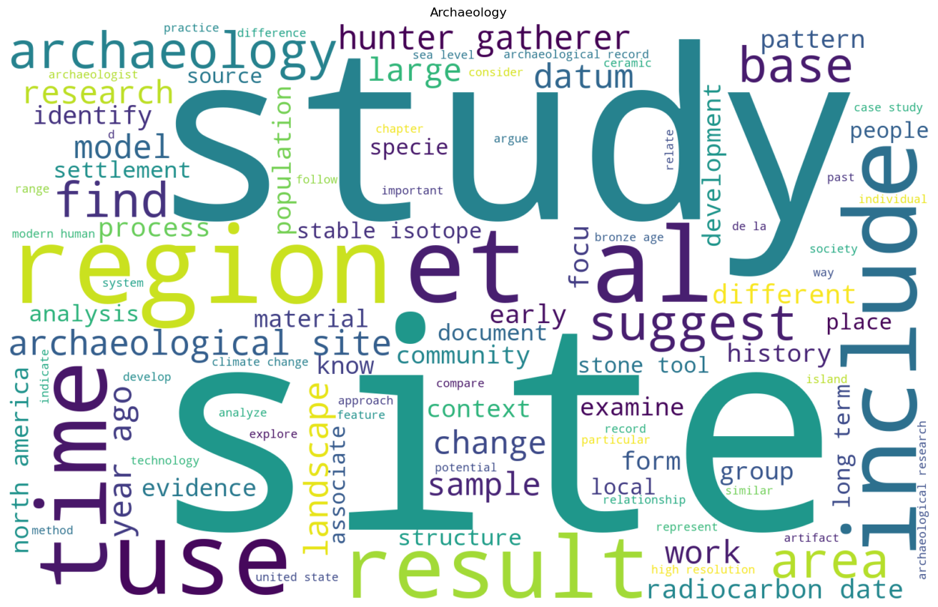

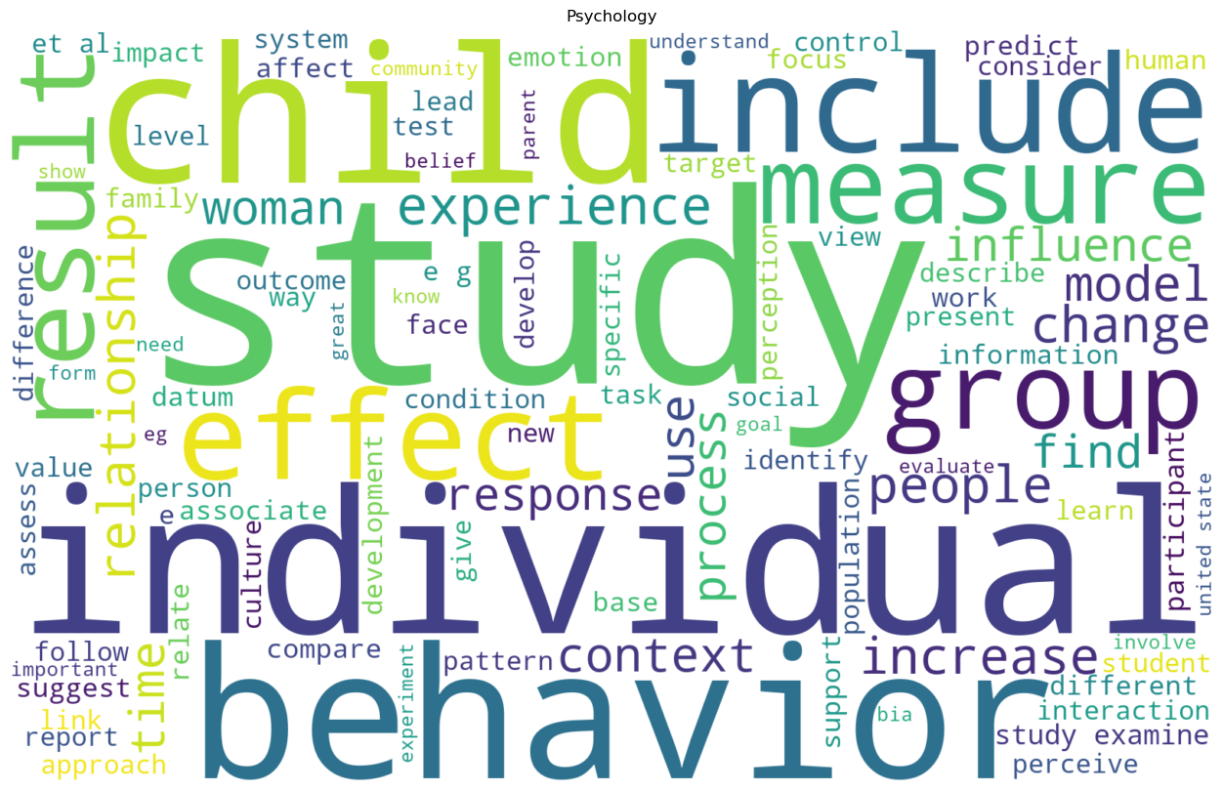
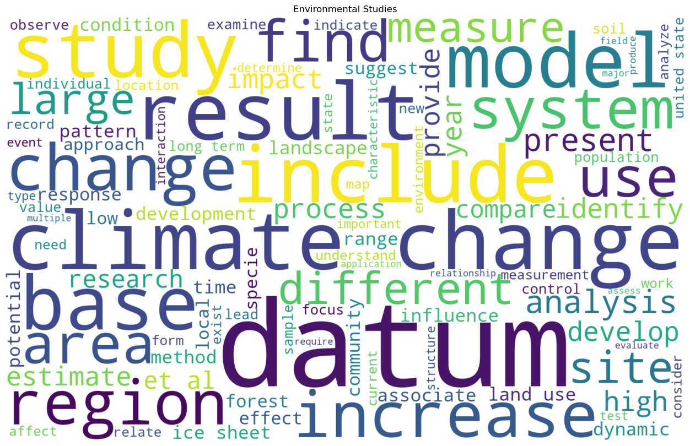
Word Clouds by Cluster
MACS 30122

Slide 12
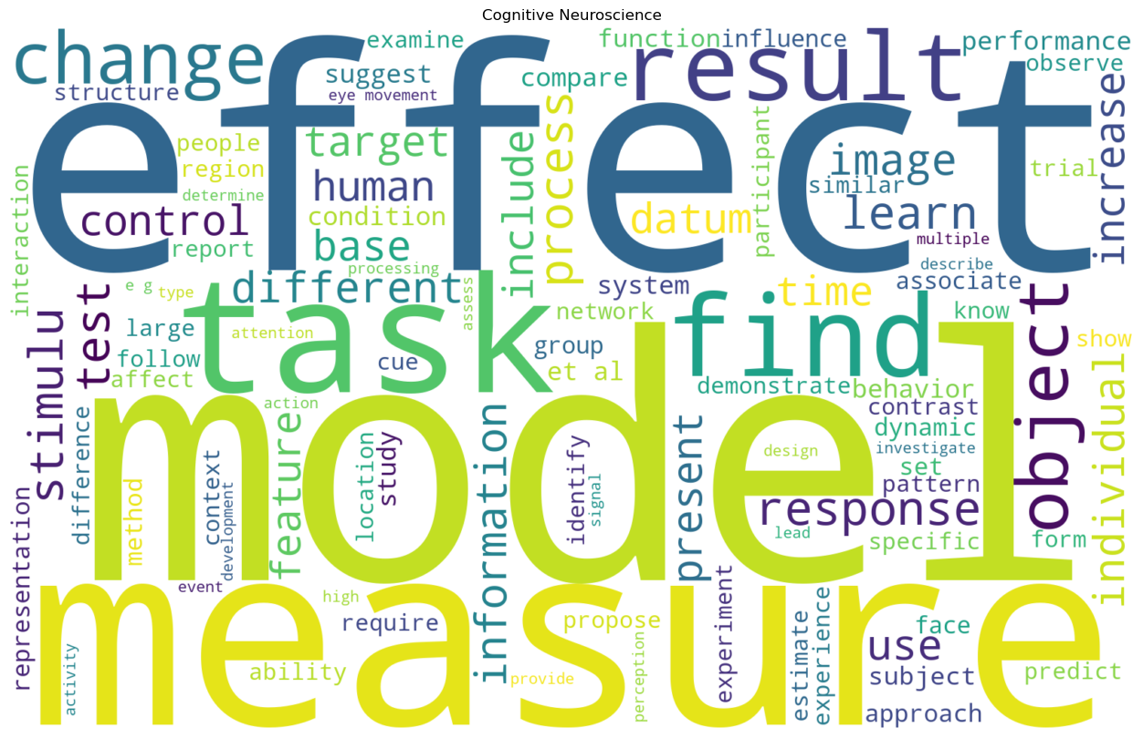
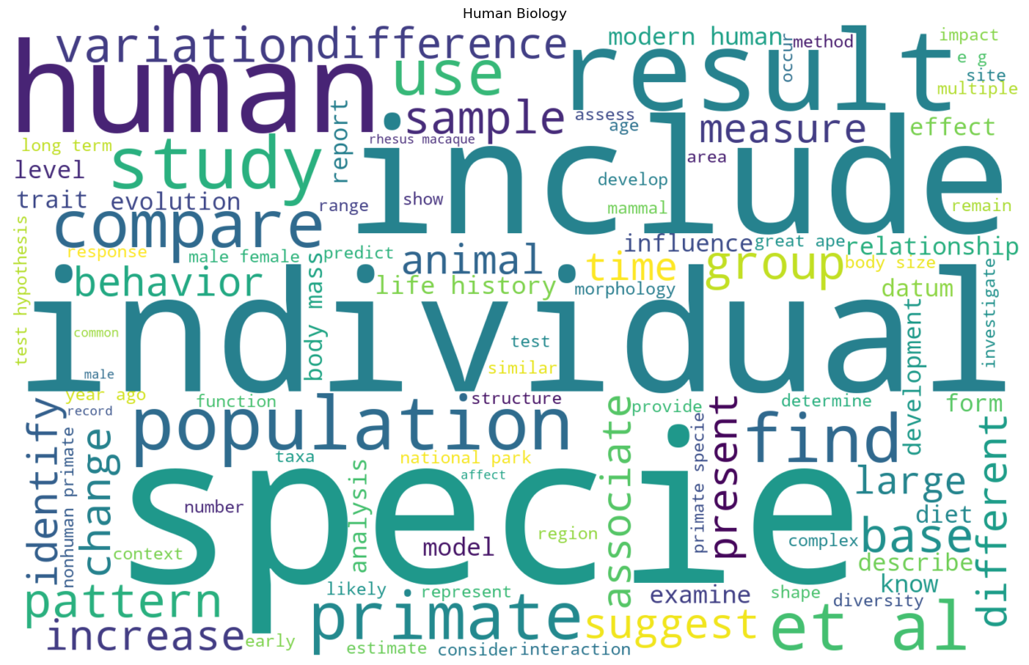
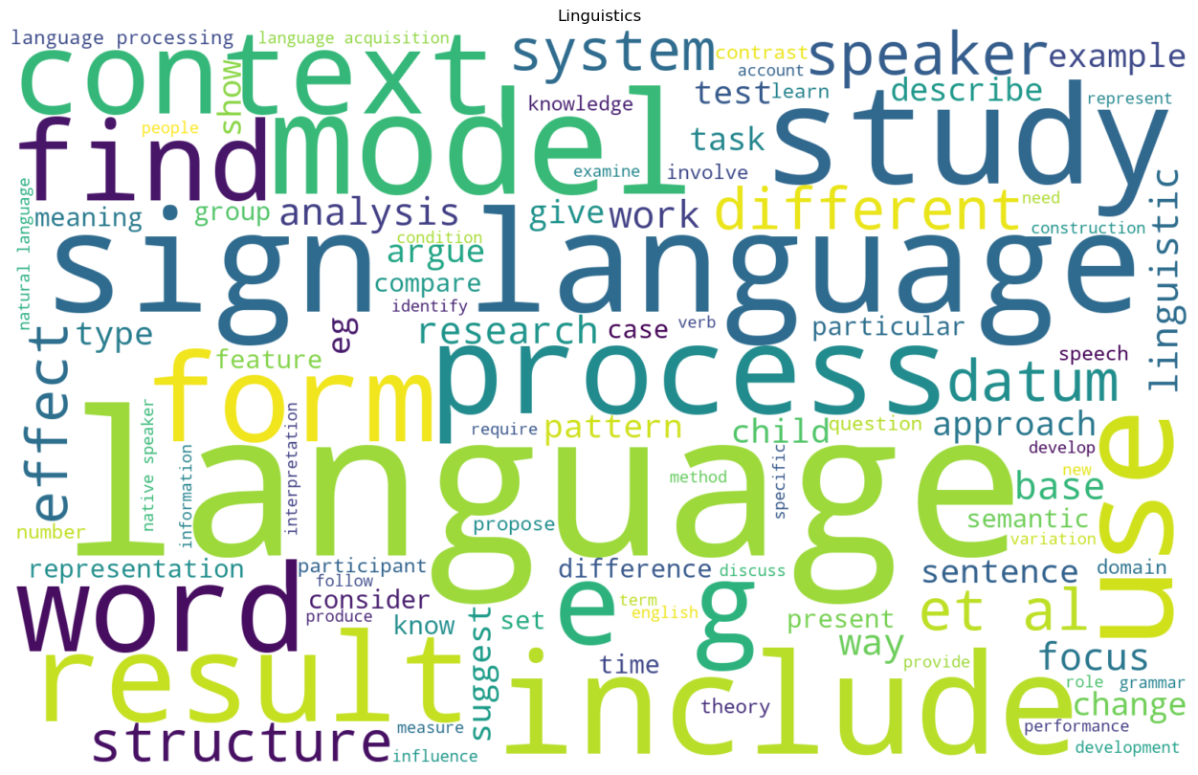
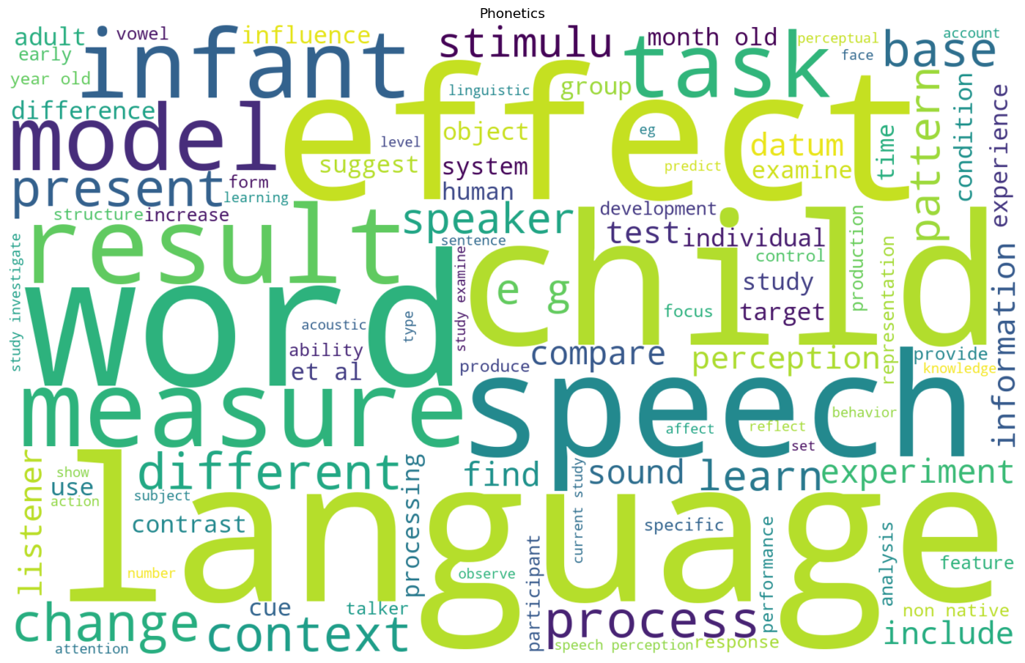
Word Clouds by Cluster
MACS 30122

Slide 13
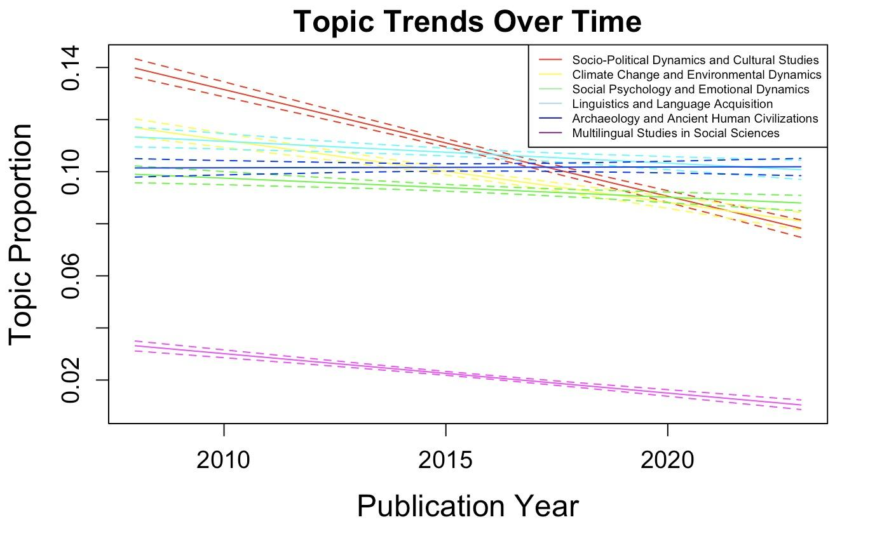
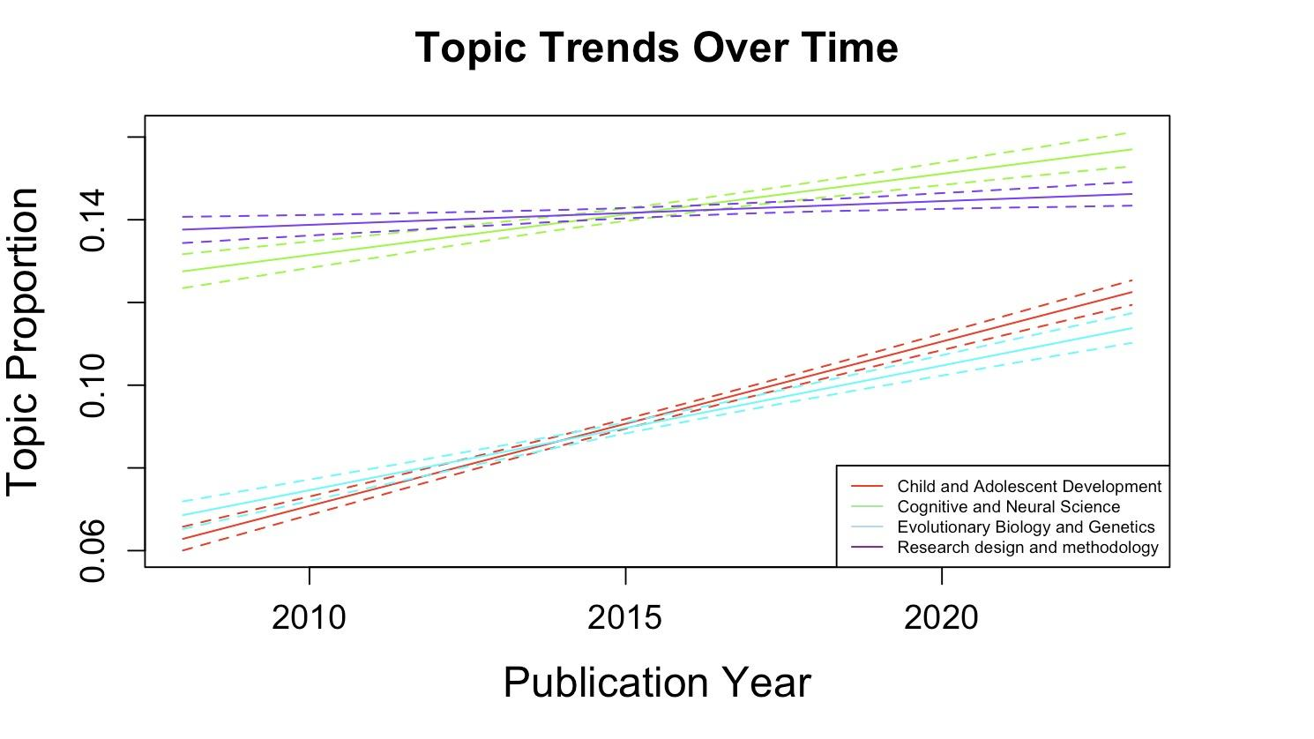
Structural Topic Modeling
Proportions of words associated with Social Sciences and Environmental Studies in paper abstracts experienced a downward trend, while those associated with Biological Sciences and Experimental Studies experienced an upward trend.
MACS 30122

Slide 14
OLS Linear Regression
Dependent variables
number of publications (quantity)
citations of top three most cited papers (quality)
Independent variables
natural log of award amount
award (binary encoding)
Control variables
h-index & total citations
Fixed effects
year
subfields based on k-means clustering
subfields based on structural topic modeling
MACS 30122

Slide 15
OLS Linear Regression (baseline)
Baseline Regression
 | (1) | (2) | (3) | (4)
 | quantity | quality | quantity | quality
ln(award amount) | 0.0909*** | -1.689***
 | (0.00997) | (0.413)
h-index | 0.143*** | 0.258 | 0.144*** | 0.252
 | (0.00565) | (1.106) | (0.00564) | (1.106)
total citations | 0.000522*** | 0.104** | 0.000522*** | 0.104**
 | (0.000185) | (0.0405) | (0.000184) | (0.0405)
award(binary) |  |  | 1.086*** | -20.18***
 |  |  | (0.149) | (4.646)
constant | -0.0455 | 36.09* | -0.0590 | 36.33*
 | (0.136) | (20.87) | (0.125) | (20.90)
N | 20113 | 19511 | 20113 | 19511
R² | 0.129 | 0.118 | 0.129 | 0.118
adj. R² | 0.128 | 0.118 | 0.128 | 0.118
Standard errors in parentheses
* p < 0.1, ** p < 0.05, *** p < 0.01
MACS 30122

Slide 16
OLS Linear Regression (panel data)
Regression Panel Data
 | (1) | (2) | (3) | (4)
 | quantity | quality | quantity | quality
ln(award amount) | 0.0961*** | -0.0108
 | (0.0126) | (0.377)
h-index | 0.142*** | -0.0970 | 0.142*** | -0.0951
 | (0.00599) | (1.129) | (0.00599) | (1.129)
total citations | 0.000558*** | 0.114*** | 0.000555*** | 0.114***
 | (0.000187) | (0.0410) | (0.000187) | (0.0410)
award(binary) |  |  | 1.135*** | -1.280
 |  |  | (0.183) | (4.143)
year | controlled | controlled | controlled | controlled
constant | -0.113 | 83.94*** | -0.134 | 84.00***
 | (0.183) | (27.70) | (0.181) | (27.70)
N | 20113 | 19511 | 20113 | 19511
R² | 0.130 | 0.132 | 0.129 | 0.132
adj. R² | 0.129 | 0.131 | 0.129 | 0.131
Standard errors in parentheses
* p < 0.1, ** p < 0.05, *** p < 0.01
MACS 30122

Slide 17
OLS Linear Regression (k-means clustering)
Panel with K-means Clustering Subfields
 | (1) | (2) | (3) | (4)
 | quantity | quality | quantity | quality
ln(award) | 0.102*** | 0.176
 | (0.0135) | (0.379)
h-index | 0.146*** | 1.388*** | 0.146*** | 1.390***
 | (0.00733) | (0.459) | (0.00737) | (0.458)
total citations | 0.000170 | 0.0576*** | 0.000172 | 0.0576***
 | (0.000222) | (0.0191) | (0.000223) | (0.0191)
award(binary) |  |  | 1.206*** | 0.755
 |  |  | (0.196) | (4.084)
year | controlled | controlled | controlled | controlled
subfield_1 | controlled | controlled | controlled | controlled
constant | -0.451** | 39.85*** | -0.483** | 39.90***
 | (0.194) | (11.42) | (0.192) | (11.38)
N | 18972 | 18405 | 18972 | 18405
R² | 0.118 | 0.088 | 0.118 | 0.088
adj. R² | 0.117 | 0.087 | 0.117 | 0.087
Standard errors in parentheses
* p < 0.1, ** p < 0.05, *** p < 0.01
MACS 30122

Slide 18
OLS Linear Regression (structural topic modeling)
Panel with Structural Topic Modeling Subfields
 | (1) | (2) | (3) | (4)
 | quantity | quality | quantity | quality
ln(award amount) | 0.104*** | 0.112
 | (0.0131) | (0.381)
h-index | 0.153*** | 1.337*** | 0.153*** | 1.339***
 | (0.00625) | (0.495) | (0.00627) | (0.493)
total citations | 0.0000459 | 0.0581*** | 0.0000439 | 0.0581***
 | (0.000218) | (0.0196) | (0.000218) | (0.0196)
award(binary) |  |  | 1.212*** | 0.404
 |  |  | (0.187) | (4.155)
year | controlled | controlled | controlled | controlled
subfield_2 | controlled | controlled | controlled | controlled
constant | 0.0777 | 36.48*** | 0.0416 | 36.49***
 | (0.423) | (12.54) | (0.417) | (12.48)
N | 18972 | 18405 | 18972 | 18405
R² | 0.117 | 0.087 | 0.117 | 0.087
adj. R² | 0.117 | 0.087 | 0.116 | 0.087
Standard errors in parentheses
* p < 0.1, ** p < 0.05, *** p < 0.01
MACS 30122

Slide 19
Conclusion
Biological Sciences are more likely to be awarded funding than Social Sciences.
Funding, and higher amount of funding have significant effects on the quantity but not quality of academic output of scholars.
MACS 30122

